Slide 1
Neurological Disorders Lesson 4.3
What makes us go to sleep and wake up?

Slide 2
Do Now:
Discuss the following questions with a partner:
What makes us fall asleep?
What makes us wake up?

Slide 3
So, what makes this happen?
Notes:
If you are having difficulties playing this video through the PowerPoint slide, you can access it online at: http://sites.tufts.edu/greatdiseases/modules/neurological-disease/multimedia-backup/

Slide 4
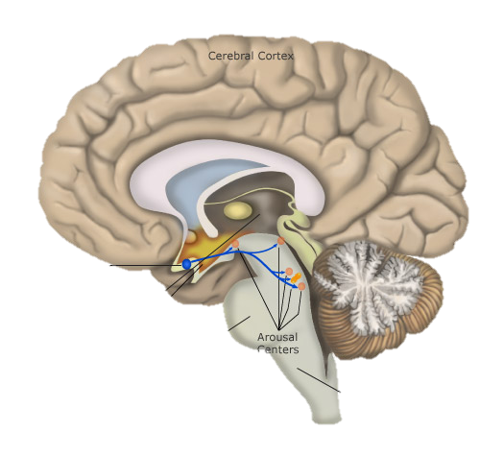
Specific brain areas keep us awake and other areas put us to sleep
Areas in the hypothalamus put us to sleep
Areas in the brainstem keep us awake
VLPO
Arousal Neurons

Slide 5
Specific brain areas keep us awake and other areas put us to sleep
Go to sleep area
Wake up area
Arousal
neurons
VLPO
Asleep!!
Awake!!
But how do they know what the other is doing???

Slide 6
The two areas connect with each other. Can you predict how they connect?
Go to sleep area
Wake up area
Arousal
neurons
VLPO
Asleep!!
Awake!!

Slide 7
The two areas connect with each other. They inhibit each other.
Go to sleep area
Wake up area
Arousal
neurons
VLPO
Asleep!!
Awake!!
But, would this work???

Slide 8
To wake up, our “wake up” area needs to be more active than the “go to sleep” area.
Go to sleep
VLPO
Wake up
Arousal
neurons
Awake!!

Slide 9
To sleep, the “go to sleep” area needs to be more active than the “wake up” area.
Wake up
Go to sleep
Arousal
neurons
VLPO
Asleep!!

Slide 10
But how is the transition from sleep to wake (and vice versa) controlled?
What makes us feel tired and sleepy?
It’s dark
You just ate and your stomach is full
You feel relaxed
What makes us feel awake and alert?
It’s light
You just slept
You feel stressed
Neurons sensitive to these signals, particularly light and dark, switch the “wake up” and “go to sleep” areas on and off.

Slide 11
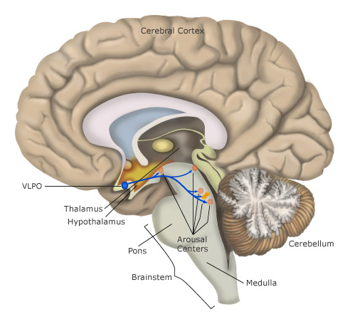
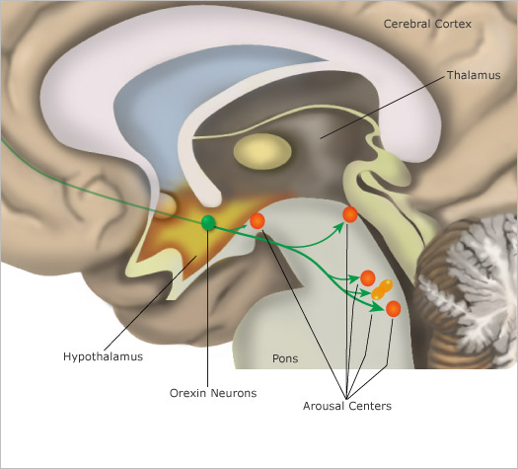
Orexin neurons in our hypothalamus are activated by signals that keep us awake.
Orexin neurons

Slide 12
Orexin neurons are activated by signals that keep us awake, and can activate the arousal neurons.
Light
Orexin neurons
Arousal
neurons
VLPO
Notes:
Metabolic cues - glucose levels, leptin and ghrelin all affect activity of orexin neurons
Light/dark cycle - SCN encodes body’s clock influences activity of orexin neurons

Slide 13
Orexin neurons are activated by signals that keep us awake, and can activate the arousal neurons.
Light
Orexin neurons
Energy balance/
metabolic cues
Emotional state
VLPO
Awake!!
Arousal
neurons
Notes:
Metabolic cues - glucose levels, leptin and ghrelin all affect activity of orexin neurons
Light/dark cycle - SCN encodes body’s clock influences activity of orexin neurons

Slide 14
What happens when the orexin neurons are switched off?
Orexin neurons
Light/Dark cycle
Energy balance/
metabolic cues
Emotional state
Arousal
neurons
VLPO
Notes:
Metabolic cues - glucose levels, leptin and ghrelin all affect activity of orexin neurons
Light/dark cycle - SCN encodes body’s clock influences activity of orexin neurons

Slide 15
What happens when the orexin neurons are switched off?
Orexin neurons
Light/Dark cycle
Energy balance/
metabolic cues
Emotional state
Arousal
neurons
VLPO
Asleep!!
Arousal neurons are switched off too.
We fall asleep.
Notes:
Metabolic cues - glucose levels, leptin and ghrelin all affect activity of orexin neurons
Light/dark cycle - SCN encodes body’s clock influences activity of orexin neurons

Slide 16
Think, Pair, Share.
Given this sleep-wake circuit, can you predict what causes Skeeter’s narcolepsy???

Slide 17
Narcolepsy
Notes:
If you are having difficulties playing this video through the PowerPoint slide, you can access it online at: http://sites.tufts.edu/greatdiseases/modules/neurological-disease/multimedia-backup/ or
http://www.youtube.com/watch?v=jTj3a2nHw8k

Slide 18
Homework: What causes narcolepsy?
In 1999 researchers identified the gene responsible for causing narcolepsy in dogs.
The gene identified was a mutation in the receptor for orexin which caused the receptor to be defective.

